Slide 1

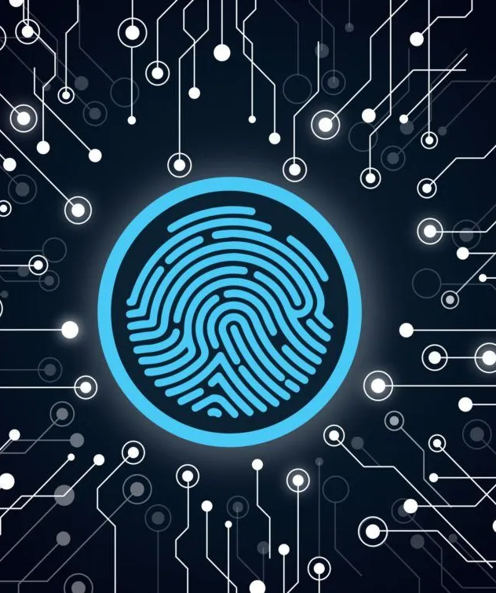

BIOMETRIC STUDENT ATTENDANCE
Presented by: GROUP 5

Slide 2
System Modeling And Design
Presented by: GROUP 5

Slide 3
OUTLINE
1
2
3
4
Introduction
Context Diagram
Class Diagram
Use Case Diagram
5
6
6
Sequence Diagram
Deployment Diagram
Conclusion

Slide 4



1-INTRODUCTION
a biometric student attendance mobile application utilizes Unified Modeling Language (UML) to illustrate the system's architecture, functionalities, and interactions through various diagrams like the context diagram, use case diagram, class diagram, sequence diagram, deployment diagram, and activity diagrams. These diagrams provide insights into design decisions, workflow processes, and technical specifications, ensuring the development of an effective and user-friendly biometric attendance solution.

Slide 5
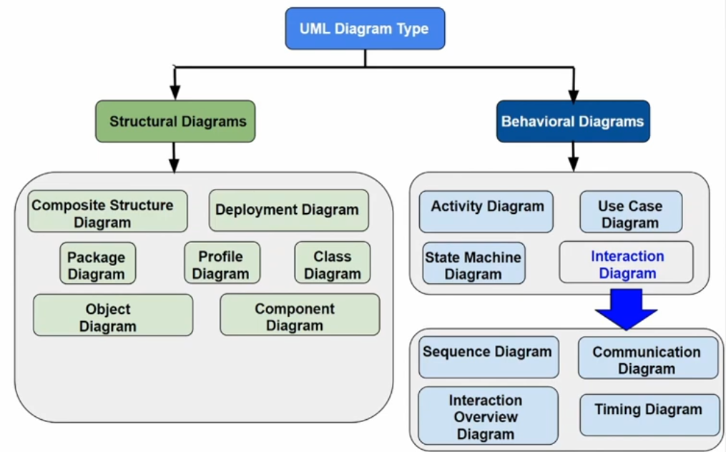

Slide 6

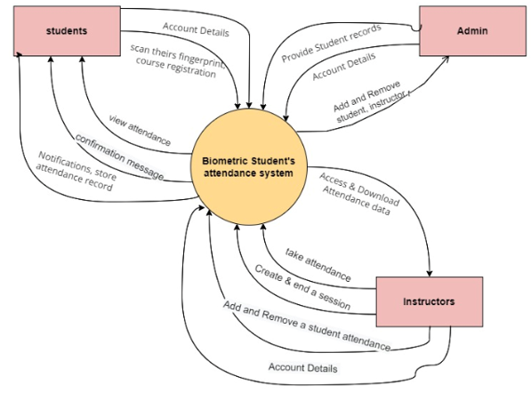
2- CONTEXT DIAGRAM
The context diagram is essential in system modeling, providing a high-level overview of the AttendEase biometric student attendance mobile application and its interactions with external entities.
Represent the external intity
Represent the system
Represent the flow of data

Slide 7

3- USE CASE DIAGRAM
A use case diagram summarizes the relationships between use cases, actors, and systems without detailing the sequence of steps for each use case. The purpose of the use case diagram are:
Specify the context of the system
Capture the requirements of the system
Validate system architecture
Drive the implementation and generate test cases
brainstorming
surveys
user persona

Slide 8
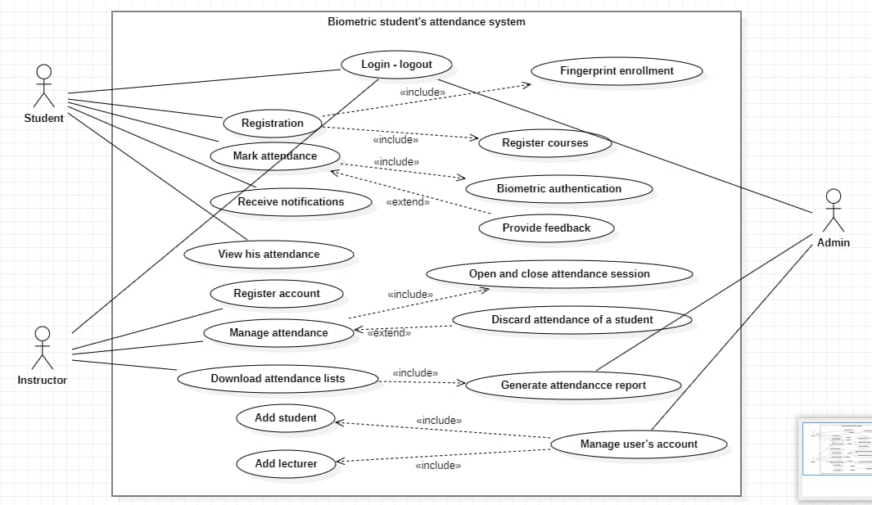
efficiency
user features
accessibility
accuracy

Slide 9


4-CLASS DIAGRAM
The class diagram outlines the core classes of the application, detailing their attributes, operations, and relationships. It focuses on entities like Student, Instructor, and Attendance, showcasing their connections and data flows. This diagram serves as a blueprint for implementing the system, ensuring organized data and functionality. It acts as a reference for developers, architects, and stakeholders, guiding the development process.

Slide 10

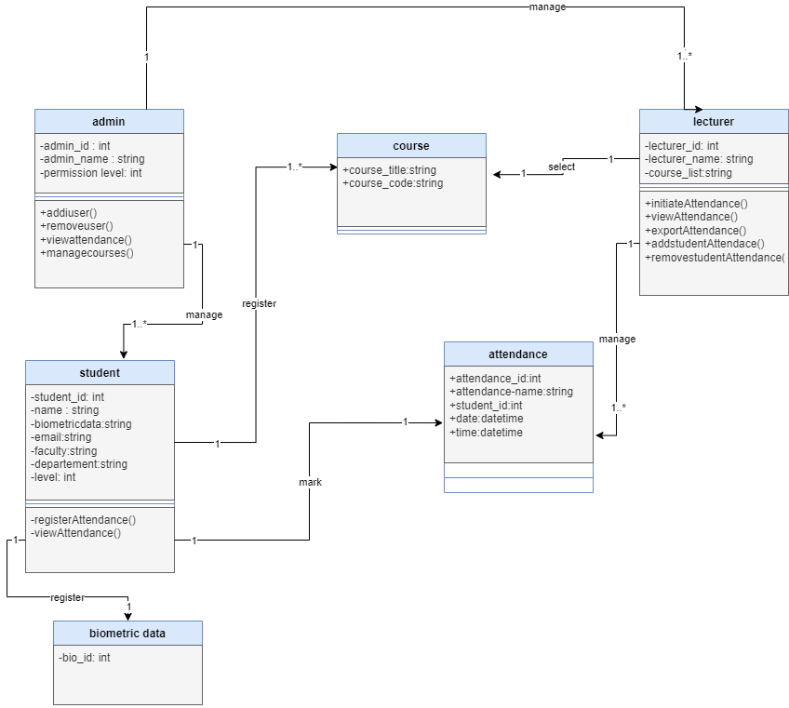


Slide 11
5- SEQUENCE DIAGRAM
The sequence diagram outlines the sequential process of student attendance via the mobile app, covering actions from session initiation to record update. It details steps such as login, biometric data capture, verification, and backend processing, depicting communication pathways between system elements. This diagram offers insights into runtime behavior and ensures alignment with functional needs

Slide 12

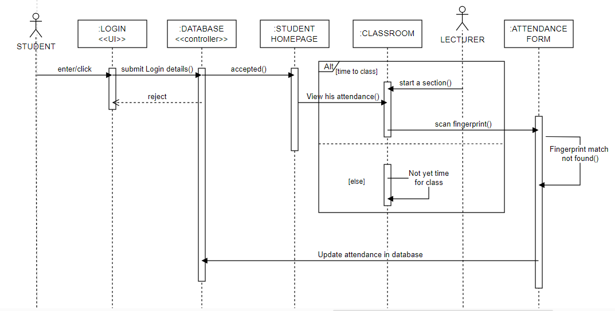

Slide 13

6- DEPLOYMENT DIAGRAM
This diagram helps to model the physical aspect of an object-oriented software system. It is mainly focused on two parts: the client application and the server application.
Identify the nodes
Client Devices : these are devices used by students, instructors, and admins such as smartphones,laptops, dekstops.
Server: the server hosting the application and database.
Define the Components
Biometric system : the component handling fingerprint registration and authentication .
Attendance Management System
Notification System
User Management System
Establish the Relationships
This is to show how the client devices connect to the seerver.
Also show the interaction between the server and the database server.
:

Slide 14
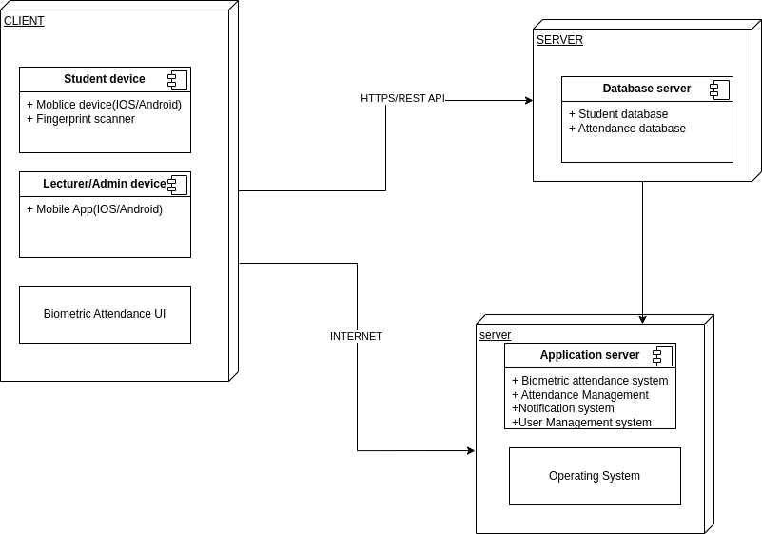

Slide 15

7-Conclusion
The biometric student attendance mobile app significantly improves attendance tracking in education. Utilizing UML for system modeling and design, the report outlines core functionalities, user interactions, and technical implementations. UML diagrams clarify the system's structure and stakeholder interactions, providing a valuable resource for development, stakeholders, and future research.

